Slide 1
亚组分析&分层因素考量

Slide 3
CONTENTS
01
分层因素的选择与数量
目录
02
亚组分析考量& TTE终点亚组分析
03
总结与实操建议

Slide 4
01.1 随机分层因素的定义与作用
Stratification Factors in Randomized Clinical Trials
定义 Definition
核心作用 Key Functions
随机分层因素是在研究设计中预先选定的受试者基线特征，往往是预后因素，通过在每个因素水平内分别进行随机组别分配，有效减少已知预后因素在治疗组间的不平衡。
确保组间均衡
减少已知预后因素在治疗组间分配不均的风险
指导亚组分析
具有预后价值或生物学合理性，是亚组分析的首要考察对象
提高统计效能
有效分层可提高统计把握度，提升试验效率
References:
1. EMA. Guideline on the investigation of subgroups in confirmatory clinical trials. 2019. Link
2. Kernan WN, et al. Stratified randomization for clinical trials. J Clin Epidemiol. 1999. 3. PMID 34117032. Link

Slide 5
01.2 分层因素选择
监管建议：
More generally, stratification by important prognostic factors measured at baseline(e.g., severity of disease, age, sex) may sometimes be valuable in order to promote balanced allocation within strata; this has greater potential benefit in small trials.
The use of more than two or three stratification factors is rarely necessary, is less successful at achieving balance, and is logistically troublesome
ICH. Statistical Principles for Clinical Trials. ICH Harmonised Tripartite Guideline. 1998.

Slide 6
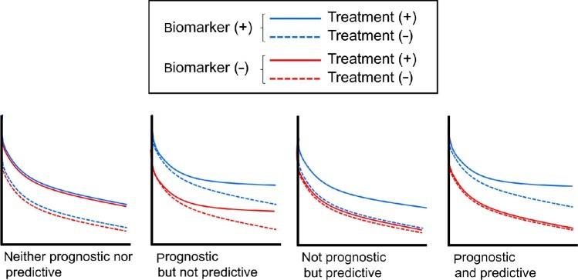
预测性因素与预后性因素的区别
预后因素 Prognostic Factor
预测因素 Predictive Factor
A biomarker used to identify likelihood of a clinical event, disease recurrence or progression in patients who have the disease or medical condition of interest.
示例：Increasing prostate-specific antigen (PSA) may be used as a prognostic biomarker when evaluating patients with prostate cancer during follow-up, to assess the likelihood of cancer progression
A biomarker used to identify individuals who are more likely than similar individuals without the biomarker to experience a favorable or unfavorable effect from exposure to a medical product or an environmental agent.
示例：BReast CAncer genes 1 and 2 (BRCA1/2) mutations may be used as predictive biomarkers when evaluating women with platinum-sensitive ovarian cancer, to identify patients likely to respond to Poly (ADP-ribose) polymerase (PARP) inhibitors
Mukohara, T. (2015). PI3K mutations in breast cancer: prognostic and therapeutic implications. Breast Cancer: Targets and Therapy, 7, 111–123. https://doi.org/10.2147/BCTT.S60696

Slide 7
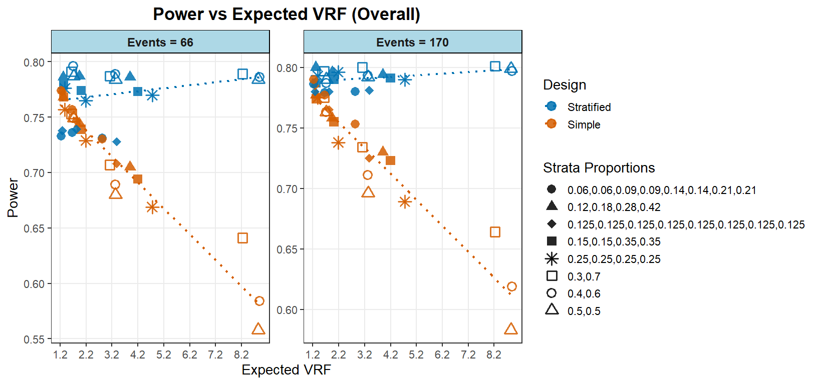
01.3 分层因素选择-预后效应
模拟问题1：预后效应与分层（不分层）随机power关系
模拟参数
Endpoint & Survival Model
Endpoint ：Time-to-Event (TTE)
Distribution ：Exponential
Treatment HR (target events): 0.5 (66 events) / 0.65 (170 events)
Block = 4
1:1 Allocation
h(t|Z) = λ₀ · exp[ Σ I(Factorⱼ) · log(HRⱼ) + βₜᵣₜ · Trt ]
3 Prognostic Factors Scenario
3 Scenarios × 4 Distributions = 12 Groups
Scenario | Max中位/min中位
 | F1 | F2 | F3
 | 2 | 3 | 5
模拟结果显示，若分层因素存在较强预后效应时，分层随机化相较于不分层可显著提升检验效能。但在总事件数仅66例、分8层的情况下，由于层数过多，即便采用分层分析，其效能仍无法达到预设的80%；且需预后效应更强时，分层优势才变得明显。无论是否存在预后效应，过度分层均会损害分层logrank检验的效力。
Strata ：2, 4, 8
Strata Proportion ：Evenly, Unevenly
Prognostic effect 和VRF关系示例
HR=0.5 Strata=2 (50：50)
层内中位 | 层间中位比值 | 对应预期VRF
层1： 21.6, 43.2 | 2 | 1.72
层2： 10.8, 21.6
层1： 27.2, 54.4 | 3 | 3.33
层2： 9.06, 18.12
层1： 36.9, 73.8 | 5 | 8.84
层2： 7.4, 14.8

Slide 8
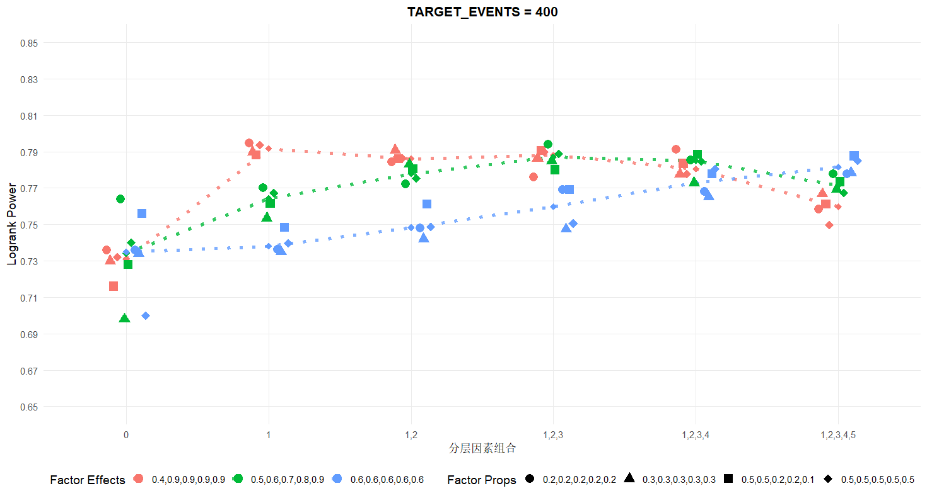
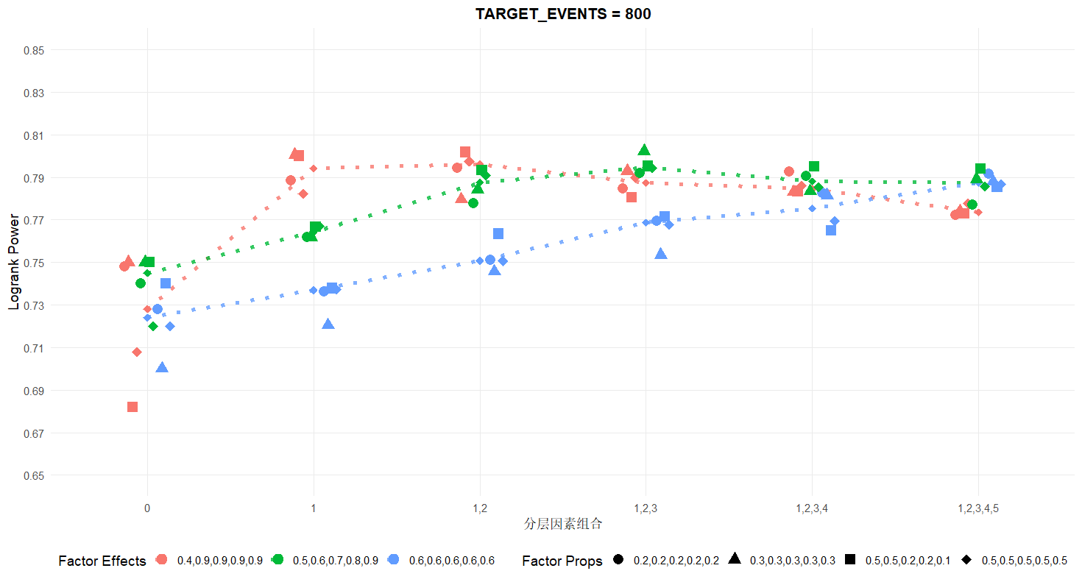
01.3 分层因素选择-预后效应
模拟问题2：TTE事件充足的情况下是否纳入越多的预后分层因素越好？
模拟参数
Endpoint & Survival Model
Endpoint ：Time-to-Event (TTE)
Distribution ：Exponential
Treatment HR (target events): 0.756 (400 events) / 0.82 (800 events)
Block = 4
1:1 Allocation
h(t|Z) = λ₀ · exp[ Σ I(Factorⱼ) · log(HRⱼ) + βₜᵣₜ · Trt ]
5 Binary Prognostic Factors
3 Scenarios × 4 Distributions = 12 Groups
Scenario | F1 | F2 | F3 | F4 | F5
Gradual | 0.5 | 0.6 | 0.7 | 0.8 | 0.9
Homogeneous | 0.6 | 0.6 | 0.6 | 0.6 | 0.6
Single Strong | 0.4 | 0.9 | 0.9 | 0.9 | 0.9
Population distribution：Balanced 50% / Skewed 30% / Rare 20% / Mixed
Stratification Strategy
Strata dimensions：0 → 1 → 2 → 3 → 4 → 5 factors
Number of strata：1 → 2 → 4 → 8 → 16 → 32

Slide 9
01.3 分层因素选择-预后效应
01
过度分层无益甚至有害
02
分层边际效能递减
03
存在最优分层个数拐点
当先对强预后因素进行矫正后，再额外纳入弱预后因素进行分层，检验效能不会提升，甚至可能下降。
弱效应因素带来的分层增益无法抵消其消耗的自由度和层内样本量/事件数缩减的代价。
若所有分层因素均为强预后因素，每增加一个分层因素均能提高 power，但提高幅度逐次缩小。
从第4个到第5个因素的增益已微乎其微，存在明显的"分层边际效能递减"现象。
当因素效应强度由弱至强（0.5→0.9），前三个因素分层后 power 显著提升。
增加第四个因素收益已很小；增加第五个因素 power 反而回落。超过3~4个因素后，继续分层不仅无益，甚至导致估计不稳定。
最终建议
在预后因素分层随机模拟或实际临床试验设计中，不宜一味追求纳入更多分层因素。应优先选择效应最强的1~3个核心预后因素进行分层，之后若仍有均衡需求，可考虑采用协变量调整等方法，而非继续增加分层维度。

Slide 10
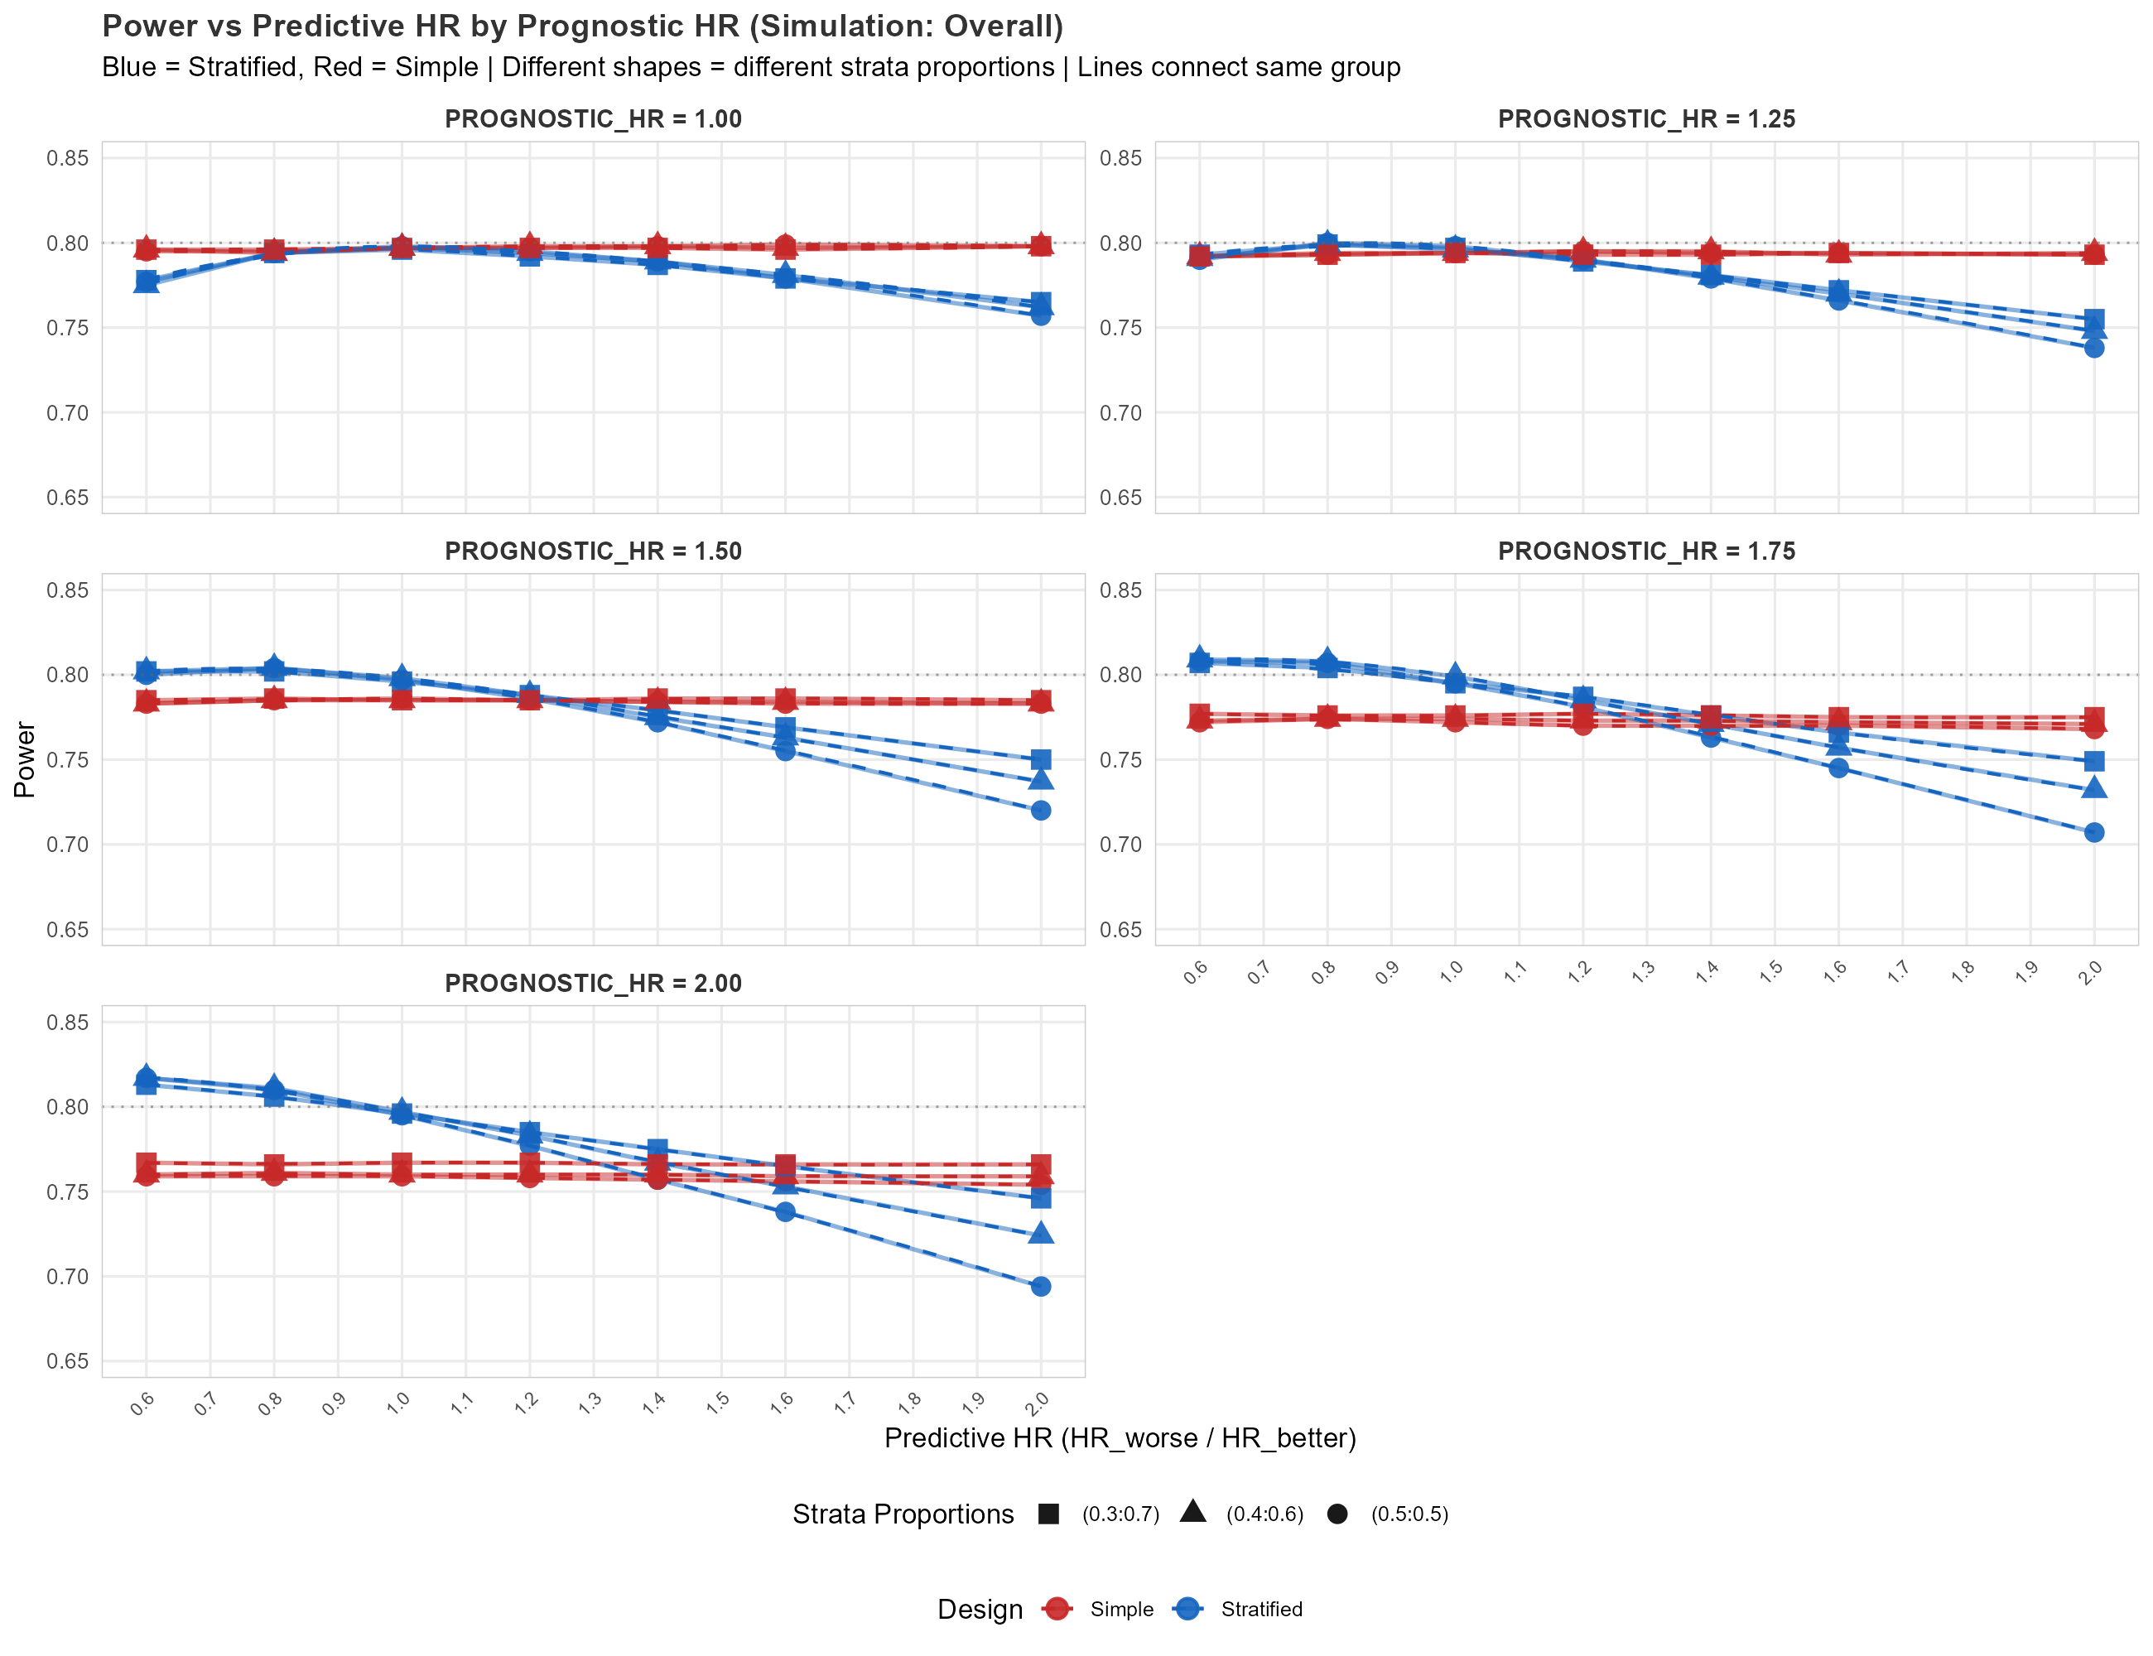
01.4 分层因素选择-预后 vs. 预测效应
模拟问题3：预后效应与预测效应同时存在的情况下，分层随机对于power如何影响？
模拟参数
Endpoint & Survival Model
Endpoint ：Time-to-Event (TTE)
Distribution ：Exponential
Treatment HR (target events): 0.65 (170events)
1:1 Allocation
Block = 4
h(t|Z) = λ₀ · exp[ Σ I(Factorⱼ) · log(HRⱼ) + Σ I(Factorⱼ) · log(HRⱼ) ⸱ Trt + βₜᵣₜ · Trt ]
1 Binary Prognostic & Predictive Factors
预后差的受试者
治疗获益更高
预后好的受试者
治疗获益更高
5 prognostic × 7 predictive= 35 Groups
Scenario | F1 | F2 | F3 | F4 | F5
Prognostic effect | 1 | 1.25 | 1.5 | 1.75 | 2
Scenario | F1 | F2 | F3 | F4 | F5 | F6 | F7
Predictive effect | 0.6 | 0.8 | 1 | 1.2 | 1.4 | 1.6 | 2
Population distribution：Balanced 50%

Slide 11
01.4 分层因素选择-预后 vs. 预测效应
基于预后效应与预测效应的不同组合，制定分层策略决策
场景一
场景二
场景三
仅有预后效应，无预测效应
预后差且疗效更优
预后好且疗效更好
一般不应纳入分层因素考虑
不损害power，但需审慎
潜在降低power，需评估
当因素仅具有预后效应（影响疾病自然进程）但不具有预测效应（不影响治疗效果）时，分层通常不会提升统计效能，只会增加试验设计复杂性。
当因素同时具有两种效应时，纳入分层需谨慎。在预后较差亚组中疗效更优时，虽不损害整体power，但需分析总体阳性结果是否主要由该亚组驱动。
当因素同时具有两种效应，且在预后较好的患者中疗效更优时，分层可能潜在降低整体检验效能，需定量评估对power的影响程度。
区分预后效应与预测效应是分层决策的基础
关注亚组效应与总体效应的一致性
定量评估power损失，权衡利弊
注：power指检验效能；预后效应指因素对疾病自然进程的影响；预测效应指因素对治疗效果的影响

Slide 12
01.5 分层因素选择流程建议
多个备选分层因素
(TTE终点)
Step 1: 操作可行性
层占比≥10%? 层数≤3?
X 排除
不可行/层过细
Step 2: 预后价值
历史层间中位比 r = max/min>=1.25 或者绝对中位差值达到一定临床意义
X 排除
无预后效应-若考虑为确证性亚组则保留
Step 3: 预测效应
结合预后效应强弱进行评估，若在预后好的组别中治疗效果强，则需要考虑分层随机power降低的问题
Step 4: 因素相关性
因素间相关性极高的可以简化
Step 5: 最终决策
预后效应排序/ 预测效应/稀疏事件层考虑
确定分层因素

Slide 13
01.7分层因素例1. STARGLO Trial: Study Design and Stratification Factors
Study Design Summary
Parameter | Details
Trial Name | STARGLO (phase 3)
Design | Randomized, open-label, placebo-controlled
Population | Untreated non–germinal center B-cell DLBCL
Randomization | 2:1 Glofit-GemOx vs R-GemOx
Primary Endpoint | Overall survival (OS)
Stratification Factors & results
 |  | Glofit-GemOx (n=183) |  | R-GemOx (n=91) |  | HR（95%CI）
 |  | Events/Median | Total no. (%) | Events/Median | Total no.（%）
outcome of last systemic therapy | Relapsed disease | 19 / NE | 71 (38.8) | 16/27.8 | 37 (40.7) | 0.51 (0.26, 0.98)
 | Refractory disease | 61 / 11.9 | 112 (61.2) | 36/7.5 | 54 (59.3) | 0.65 (0.43, 0.99)
No. of previous lines of systemic therapy | 1 | 44/NE | 115 | 28/15.7 | 57 (62.6) | 0.68 (0.42, 1.09)
 | >=2 | 36/18.3 | 68 | 24/6.7 | 34 (37.4) | 0.55(0.33, 0.93)
PFS = progression-free survival; bid = twice daily; q3w = every 3 weeks. Patients were eligible regardless of surgical outcome or BRCA mutation status.

Slide 14
01.7分层因素例2. POLARIX Trial: Study Design and Stratification Factors
Study Design Summary
Parameter | Details
Trial Name | POLARIX(phase 3)
Design | Randomized, double-blind, placebo-controlled
Population | Previously Untreated Diffuse Large B-Cell Lymphoma
Randomization | 1:1 pola-R-CHP vs R-CHOP
Primary Endpoint | Investigator-assessed PFS (progression-free survival)-228 events
Stratification Factors & results
 |  | Pola-R-CHP (n=440) |  | R-CHOP (n=439) |  | HR（95%CI）
 |  | Events | Total no. (%) | Events | Total no.（%）
IPI score | 2 | / | 167 (38.0) | / | 167 (38.0) | 1.0(0.6-1.6)
 | 3-5 | / | 273 (62.0) | / | 272 (62.0) | 0.7(0.5-0.9)
Bulky disease | Presence | / | 193 (43.9) | / | 192 (43.7) | 1 (0.7-01.5)
 | Absence | / | 247(56.1) | / | 247 (56.3) | 0.6(0.4-0.8)
geographic region | Western Europe, United States, Canada, and Australia | / | 302 (68.6) | / | 301 (68.6) | 0.8(0.6-1.1)
 | Asia | / | 81 (18.4) | / | 79 (18.0) | 0.6(0.4-1.5)
 | Rest of world | / | 57 (13.0) | / | 59 (13.4) | 0.9(0.6-1.5)
来源：Tilly H, et al. Polatuzumab Vedotin in Previously Untreated Diffuse Large B-Cell Lymphoma. N Engl J Med 2022;386:351-363. DOI: 10.1056/NEJMoa2115304

Slide 15
01.7分层因素例3. PHOENIX Trial: Study Design and Stratification Factors
Study Design Summary
Parameter | Details
Trial Name | PHOENIX(phase 3)
Design | Randomized, double-blind, placebo-controlled
Population | Untreated non–germinal center B-cell DLBCL
Randomization | 1:1 ibrutinib plus R-CHOP vs placebo plus R-CHOP
Primary Endpoint | Event-free survival (EFS) in the intentto-treat (ITT) population and the activated B-cell (ABC) DLBCL subgroup
Stratification Factors & results
 |  | Ibrutinib +R-CHOP (n=419) |  | Placebo +R-CHOP (n=419) |  | HR（95%CI）
 |  | Events | Total no. (%) | Events | Total no.（%）
R-IPI (1-2 vs. 3-5) | 1-2 | 45 | 236 (56.3) | 56 | 238 (56.8) | 0.79 (0.53 to 1.17)
 | 3-5 | 73 | 183 (43.7) | 73 | 181 (43.2) | 1.07 (0.77 to 1.48)
region | U.S./Western Europe | 30 | 131 (31.3) | 26 | 131 (31.3) | 1.22 (0.72 to 2.06)
 | Rest of World | 88 | 288 (68.7) | 103 | 288 (68.7) | 0.85 (0.64 to 1.13)
pre-specified treatment cycles | 6 cycles | 68 | 246 (58.7) | 75 | 246 (58.7) | 0.92 (0.66 to 1.28)
 | 8 cycles | 50 | 173 (41.3) | 54 | 173 (41.3) | 0.92 (0.63 to 1.36)
PFS = progression-free survival; bid = twice daily; q3w = every 3 weeks. Patients were eligible regardless of surgical outcome or BRCA mutation status.

Slide 16
01.7分层因素例4. PAOLA-1 Trial: Study Design and Stratification Factors
Study Design Summary
Parameter | Details
Trial Name | PAOLA-1 (phase 3)
Design | Randomized, double-blind, placebo-controlled
Population | Newly diagnosed advanced high-grade ovarian cancer with response after first-line platinum–taxane chemotherapy plus bevacizumab
Randomization | 2:1 (Olaparib : Placebo)
Primary Endpoint | Investigator-assessed PFS (progression-free survival)
Stratification Factors & results
 |  | Olaparib (n=537) |  | Placebo (n=269) |  | HR（95%CI）
 |  | Events | Total no. (%) | Events | Total no.（%）
Response after First-Line Treatment | No evidence of disease | 119 | 290 (54) | 92 | 141 (52) | 0.53 (0.40–0.70)
 | Complete response | 54 | 106 (20) | 42 | 53 (20) | 0.44 (0.29–0.66)
 | Partial response | 107 | 141 (26) | 60 | 75 (28) | 0.86 (0.63–1.19)
Tumor BRCA Mutation Status | Mutation positive | 41 | 161 (30)-随机数据 157(29.2)-EDC数据 | 49 | 80 (30) | 0.31 (0.20–0.47)
 | Mutation negative | 239 | 376 (70)-随机数据 380(61.8)-EDC数据 | 145 | 189 (70) | 0.71 (0.58–0.88)
Ray-Coquard, Isabelle, et al. "Olaparib plus bevacizumab as first-line maintenance in ovarian cancer." New England Journal of Medicine 381.25 (2019): 2416-2428.
PFS = progression-free survival; bid = twice daily; q3w = every 3 weeks. Patients were eligible regardless of surgical outcome or BRCA mutation status.

Slide 17
02 亚组分析
亚组分析是基于总研究人群中某些患者特征对治疗效果进行的评估，对于关键性肿瘤试验的解读具有重要意义
Inferential
Supportive
Exploratory
推断性亚组分析
支持性亚组分析
探索性亚组分析
具有统计假设，控制一类错误并具有足够的检验效能，旨在确立特定亚组中的疗效
Prespecified with adequate power and alpha control, with an intent to establish efficacy in a subgroup of interest.
预先设定，但无正式统计学假设，旨在证明总人群疗效后，描述性评估各亚组间疗效的一致性
Pre-specified, but do not include prospective planning for testing within subgroups. Aimed at descriptively investigating consistency of treatment effect across subgroups after the treatment effect is shown to be significant in the total population.
通常纳入方案以最大化临床试验数据的利用价值，用于生成假设或深入了解治疗的潜在预测性机制因素及疾病的生物学特征
Generally included in the protocol to maximize the utility of the clinical trial data to generate hypotheses or to gain further insight into potentially predictive mechanistic elements of the treatment and biological characteristics of the disease.
Amatya AK, Fiero MH, Bloomquist EW, et al. Subgroup Analyses in Oncology Trials: Regulatory Considerations and Case Examples. Clin Cancer Res. 2021;27(21):5753-5756. doi:10.1158/1078-0432.CCR-20-4912

Slide 18
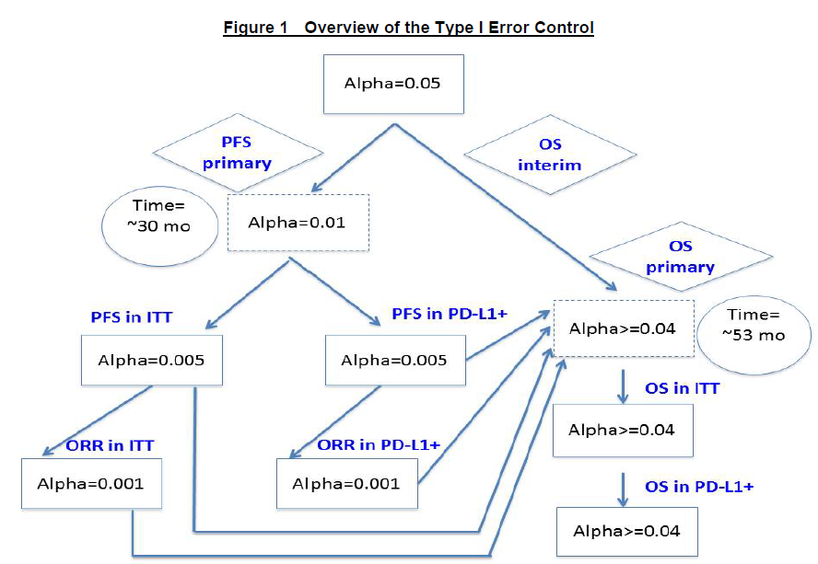
推断性亚组分析例子: IMpassion130 PD-L1 Example
Trial Design
Phase 3, randomized, double-blind, placebo-controlled
Population: First-line mTNBC (N = 902)
Randomization: 1:1 to Atezo + nP vs Placebo + nP
Dual primary endpoints: PFS and OS in ITT and PD-L1+
PD-L1+ prevalence: ~41% (n ≈ 369)
Assuming a PD-L1-elected rate of 40% in the enrolled population and assuming a median PFS of 6 months in the placebo + nab-paclitaxel arm and 12 months in the atezolizumab + nab-paclitaxel arm (corresponding to a HR of 0.5) in the PD-L1-selected subgroup, it is predicted that there will be about 215 PFS events (59.8% of 360). This corresponds to a power of about 75% and a minimally detectable difference of HR = 0.57 (corresponding to an increase of about 4.5 months from 6 months to 10.5 months).
Endpoint (PD-L1+) | Atezo + nP | Placebo + nP | HR (95% CI) | P-value
PFS (months) | 7.5 | 5.0 | 0.62 (0.49–0.78) | <0.001*

Slide 19
临床研究中亚 ge组分析的 General Good Practice
02.1 亚组分析 General Good Practice & 常用分类
01 预先规定 Pre-specification
人口统计学特征
在试验方案及SAP中预先设定亚组分析，亚组定义应基于疾病机制、已知预后或预测因素，而非纯数据驱动；
年龄、性别、种族、遗传
或生物标志物等基线特征
02 样本量考量 Adequate per subgroup objective
基于亚组的目的进行计划，确保目标亚组有足够样本量
环境因素
疾病特征
地理位置、气候、文化背景、
生活方式等外部条件
疾病严重程度、病程、
疾病亚型或表型等
03 透明报告 Transparent Reporting
明确区分预先规定与探索性分析，以森林图展示各亚组效应，结合临床背景与其他证据综合解读
临床考虑因素
地区或中心
合并用药、既往治疗史、合并症等治疗背景
不同研究机构、地区医疗水平差异的系统性影响

Slide 20
02.2 亚组分析样本量考量
监管建议：
Sample size for a trial is usually planned in order to meet trial objectives based on analysis of the whole population. However, it is recommended also to consider whether sufficient evidence will be generated in key subgroups, to support the assessment of consistency of treatment effects. This needs to be considered on a case-by-case basis, depending on the risk, a priori, to observe an inconsistent treatment effect. This can be of particular interest when considering countries (or regions).
EMA. Guideline on the investigation of subgroups in confirmatory clinical trials. EMA/CHMP/539146/2013. 31 January 2019.

Slide 21
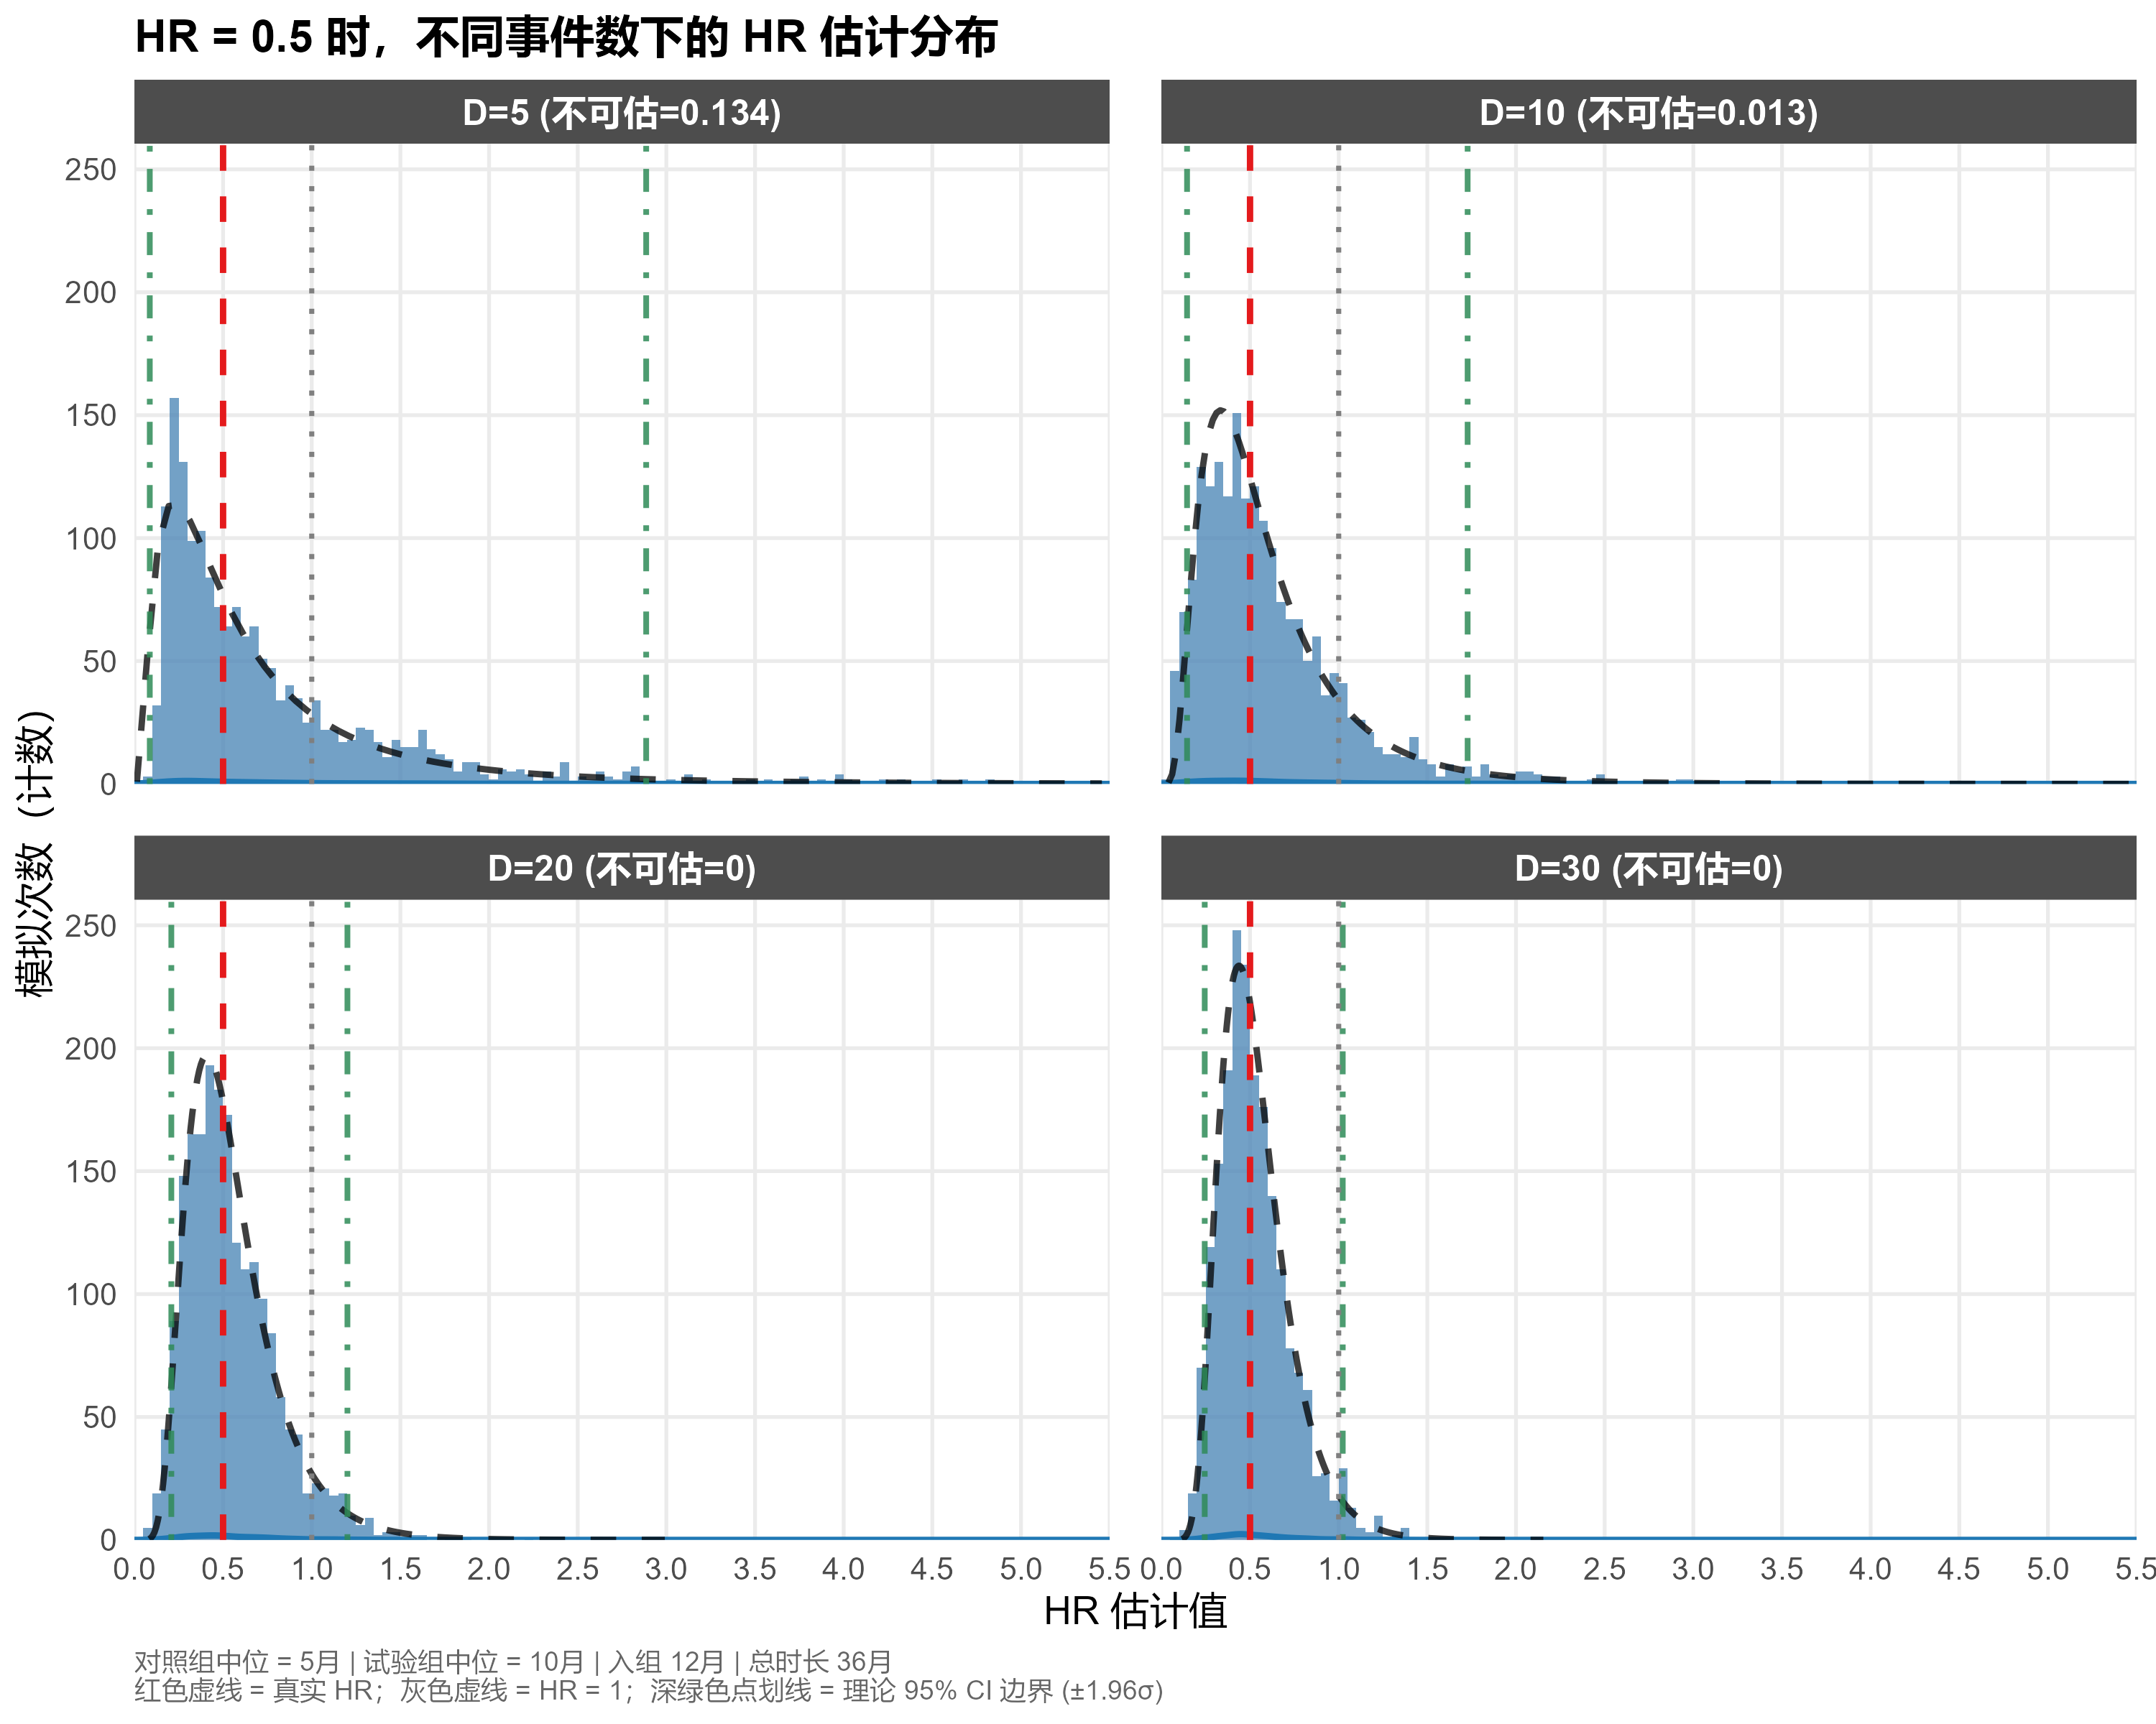
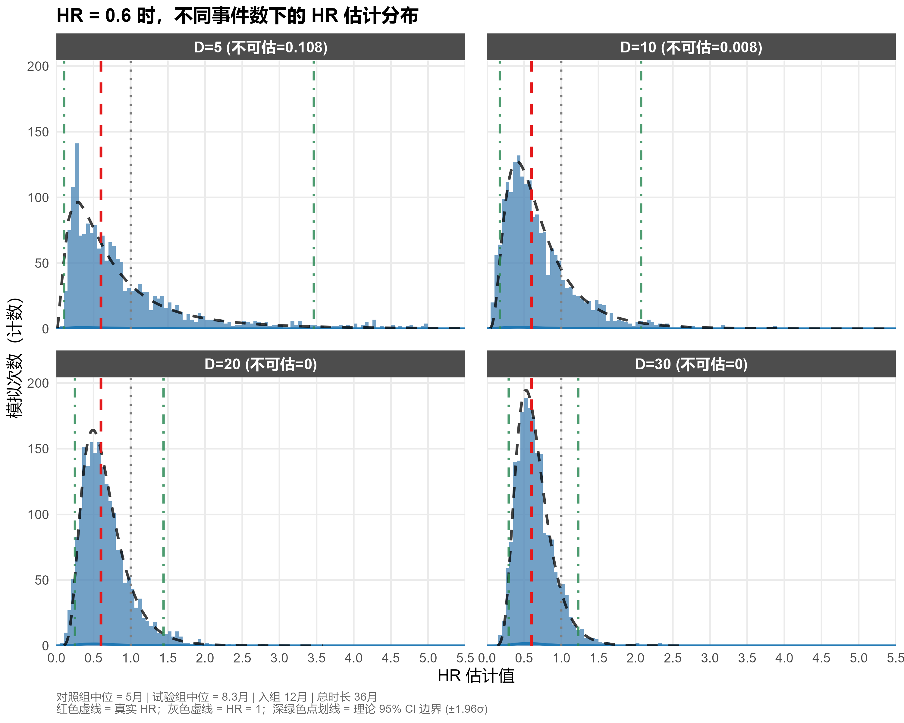
02.3 TTE终点亚组分析样本量考量
疗效估计角度：
本模拟采用1:1随机化设计，通过指数分布生成两组生存数据：对照组中位生存时间可指定（如5个月），试验组中位由目标HR反推（HR=0.5即中位10个月）。患者按均匀分布在设定入组期内入组（如12个月），研究总时长固定（如36个月）。
模拟采用事件驱动截断：当观察到预设总事件数 D （如5、10、20、30）时即行分析，拟合Cox比例风险模型提取HR估计值。

Slide 22
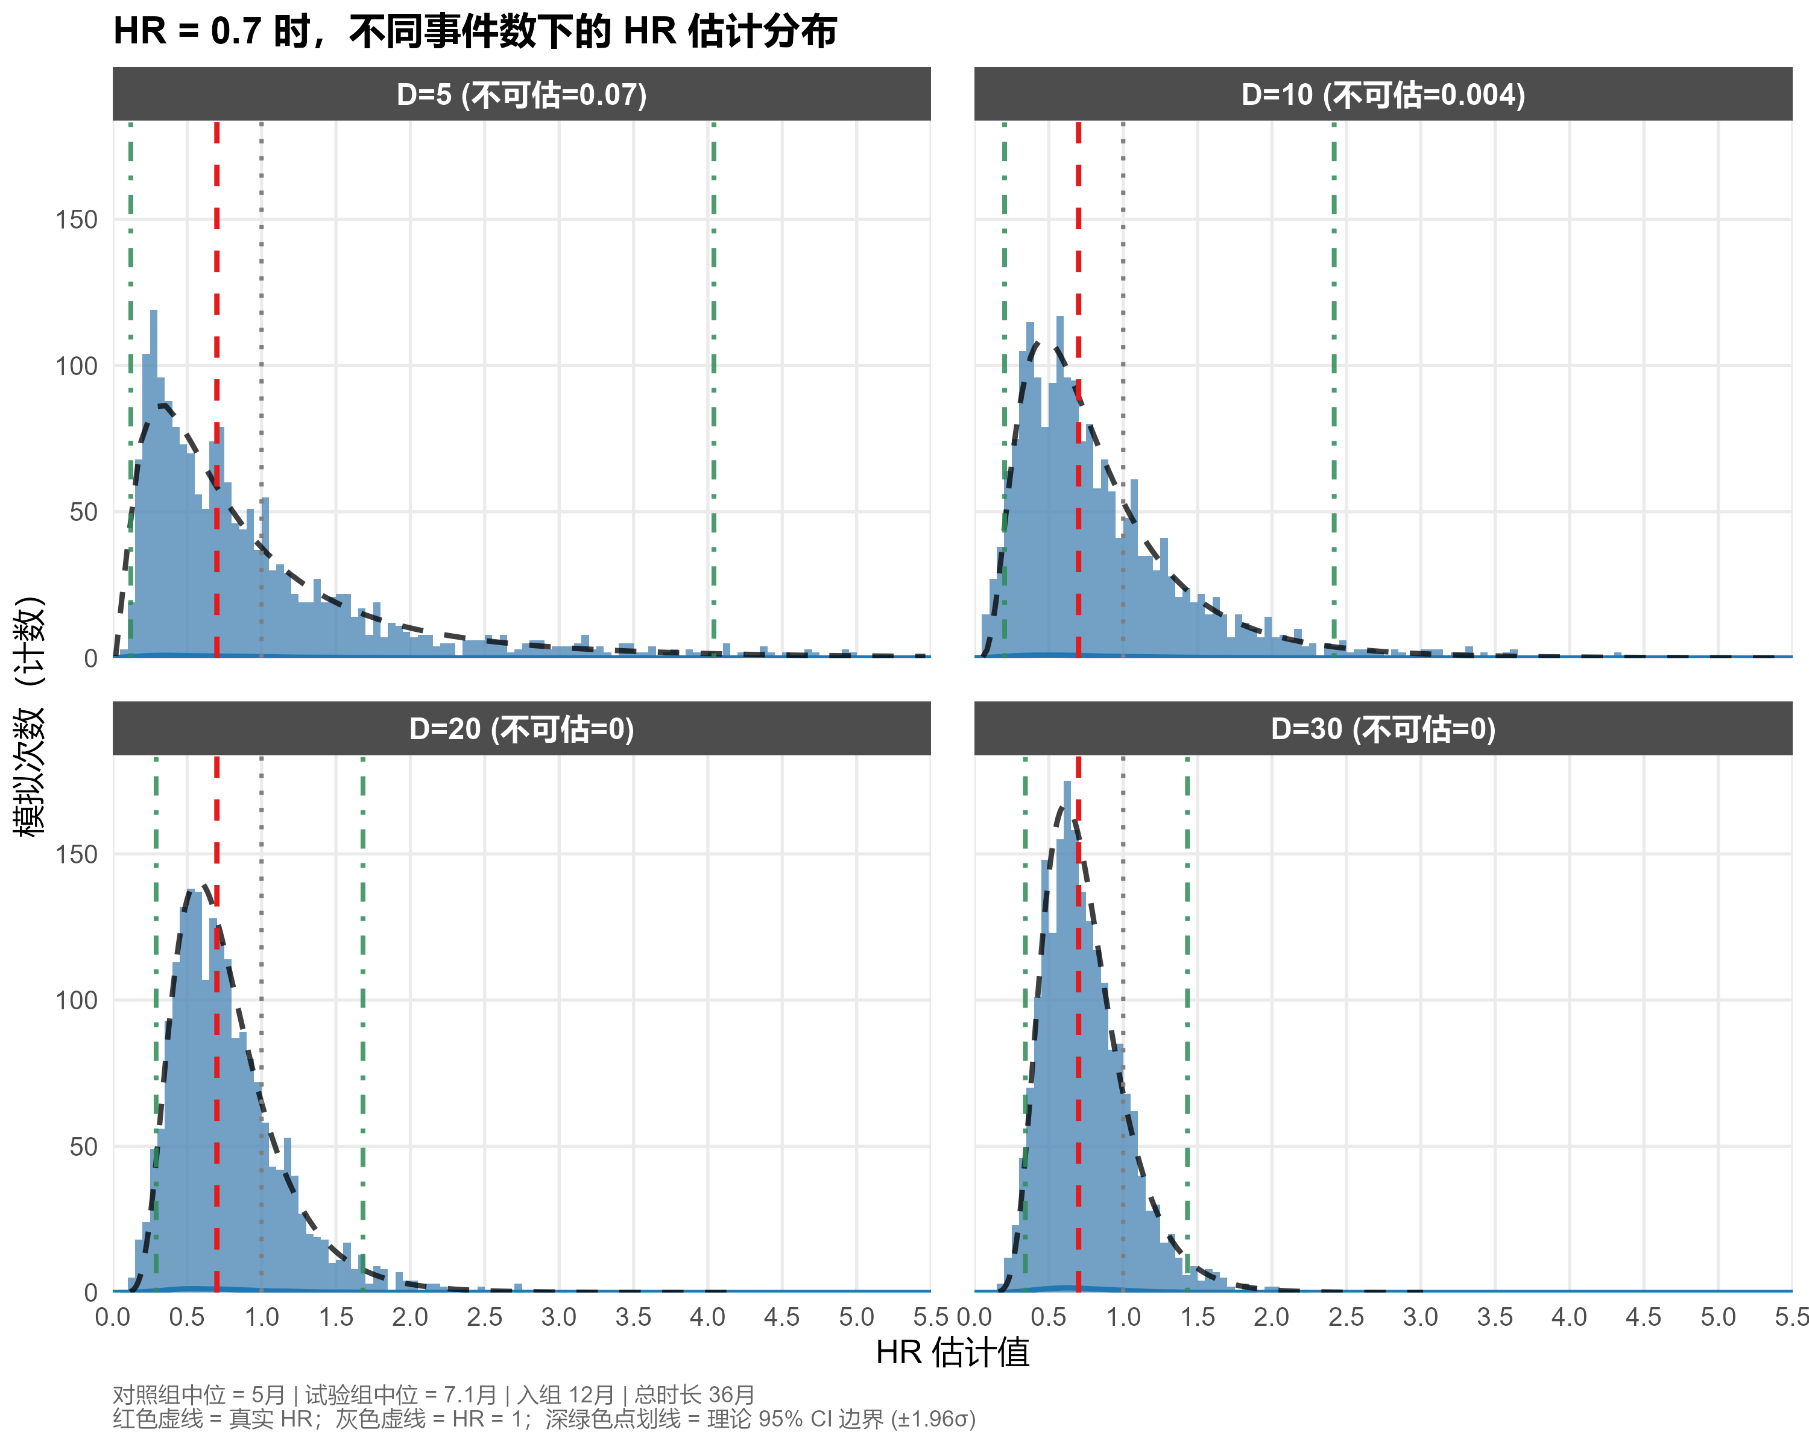
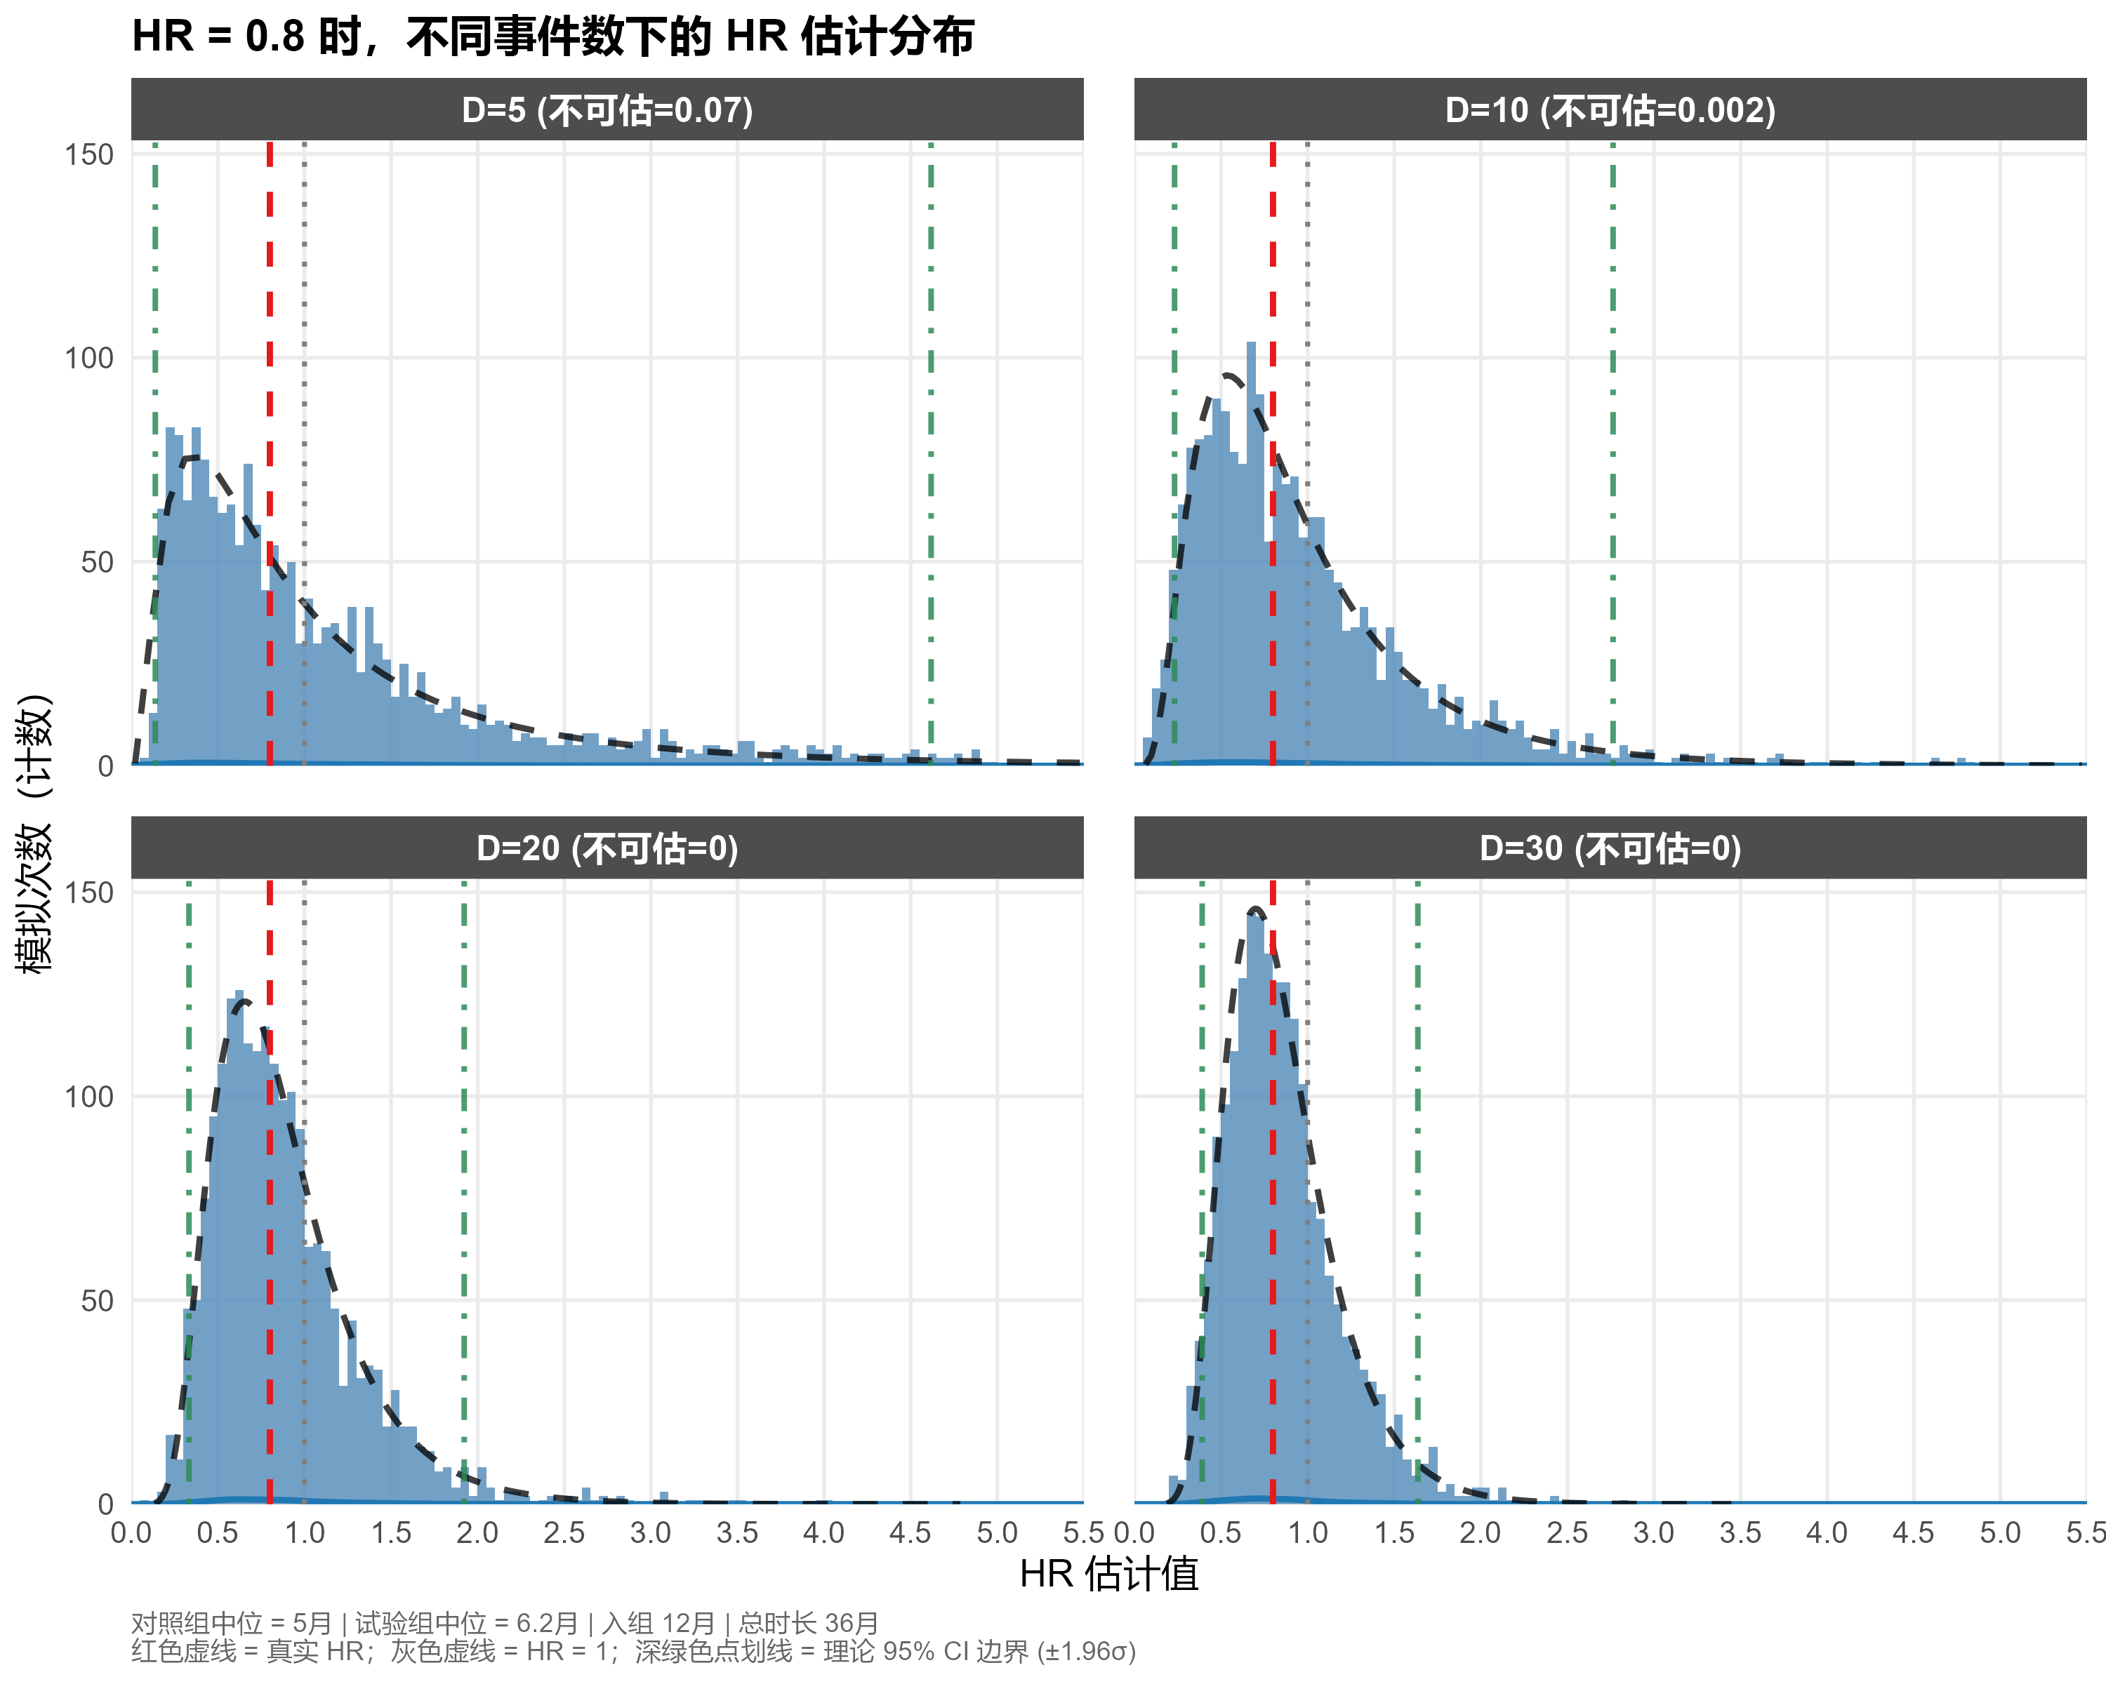
02.3 TTE终点亚组分析样本量考量
疗效估计角度：
模拟研究提示，以亚组事件数≥20作为分析阈值时，HR估计结果稳健，置信区间范围合理，并可完全避免HR不可估计的问题。

Slide 23
02.4 亚组分析案例 –TTE 终点
1. PAOLA-1 Trial SAP针对亚组事件数规定：
Subgroup PFS analyses will be conducted to assess consistency of treatment effect across potential or expected prognostic factors, including stratification factors. An analysis will not be performed if there are too few events available for a meaningful analysis of a particular subgroup (less than 20 events in a subgroup).
2. SOLO1 Trial SAP 针对亚组事件数规定：
If there are too few events available for a meaningful analysis of a particular subgroup (it is not considered appropriate to present analyses where there are less than 20 events in a subgroup), the relationship between that subgroup and PFS will not be formally analysed. In this case, only descriptive summaries will be provided.
3. PRIME Trial SAP 针对亚组事件数规定：
Subgroup analyses will be performed to assess the consistency of treatment effect across potential or expected prognostic factors. If there are too few events in a particular subgroup, i.e. <20 events per subgroup level, only descriptive summaries will be provided. Combining relevant subgroup levels may be considered if necessary.
Ray-Coquard, Isabelle, et al. "Olaparib plus bevacizumab as first-line maintenance in ovarian cancer." New England Journal of Medicine 381.25 (2019): 2416-2428.

Slide 24
03 总结

